Slide 1
The Long Civil Rights Movement:
A Documentary History
Notes:
Presentation covers the time span from the Civil War Amendments through the assassination of Dr. King and the Memphis Garbage Workers’ Strike of 1968 of which Dr. King was a part.

Slide 2
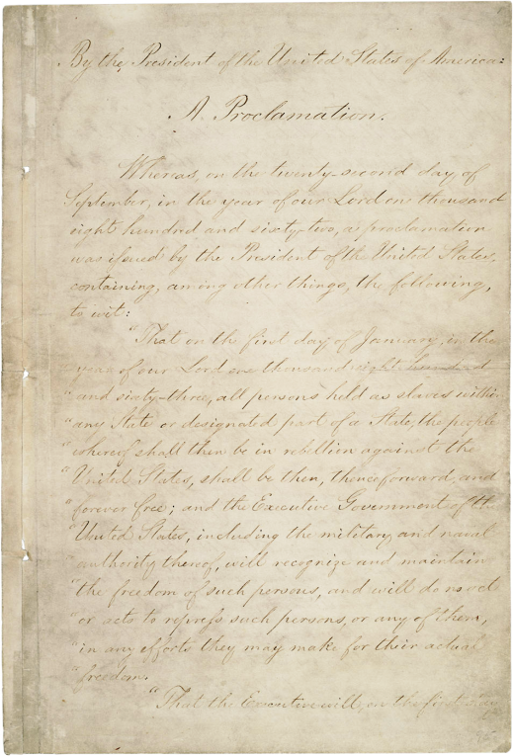
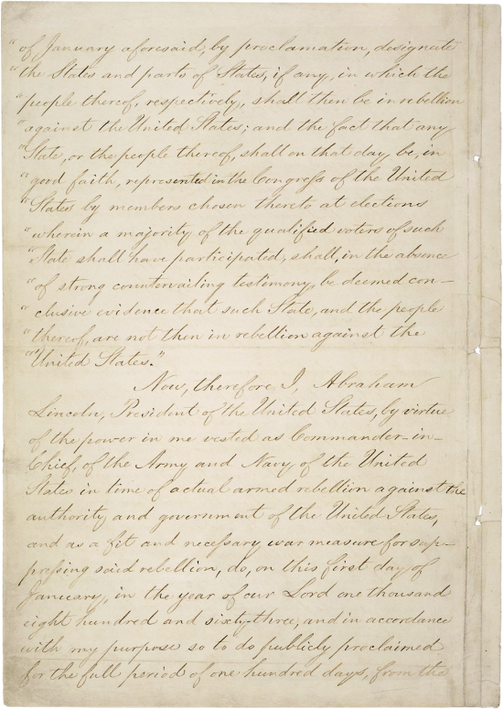
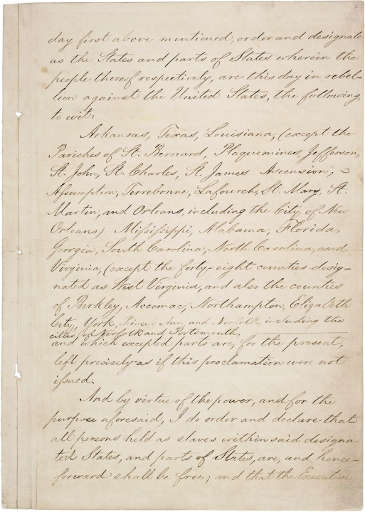
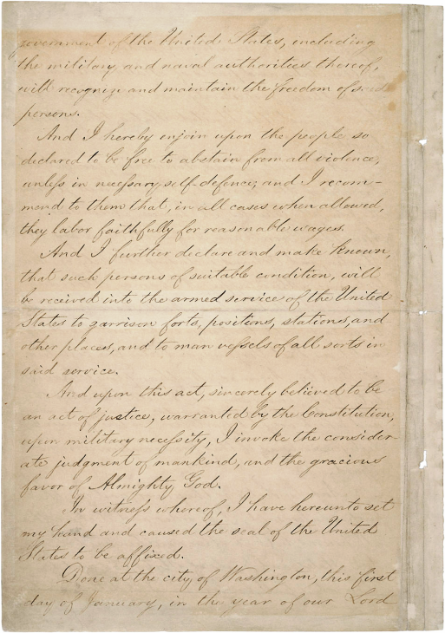
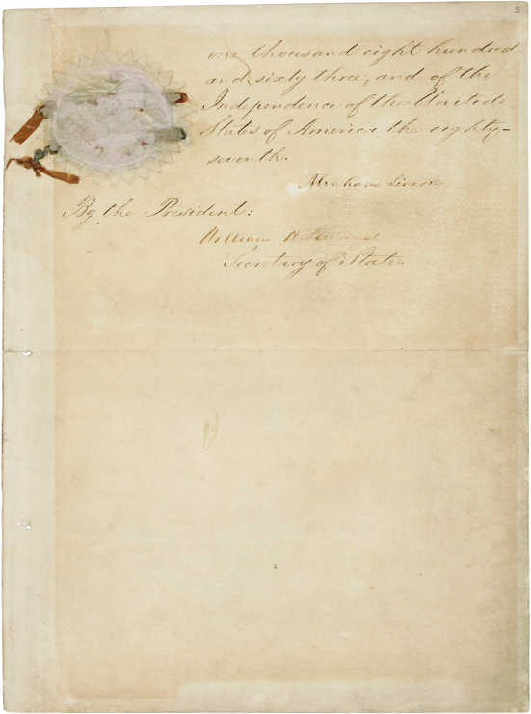
The Emancipation Proclamation, January 1, 1863

Slide 3
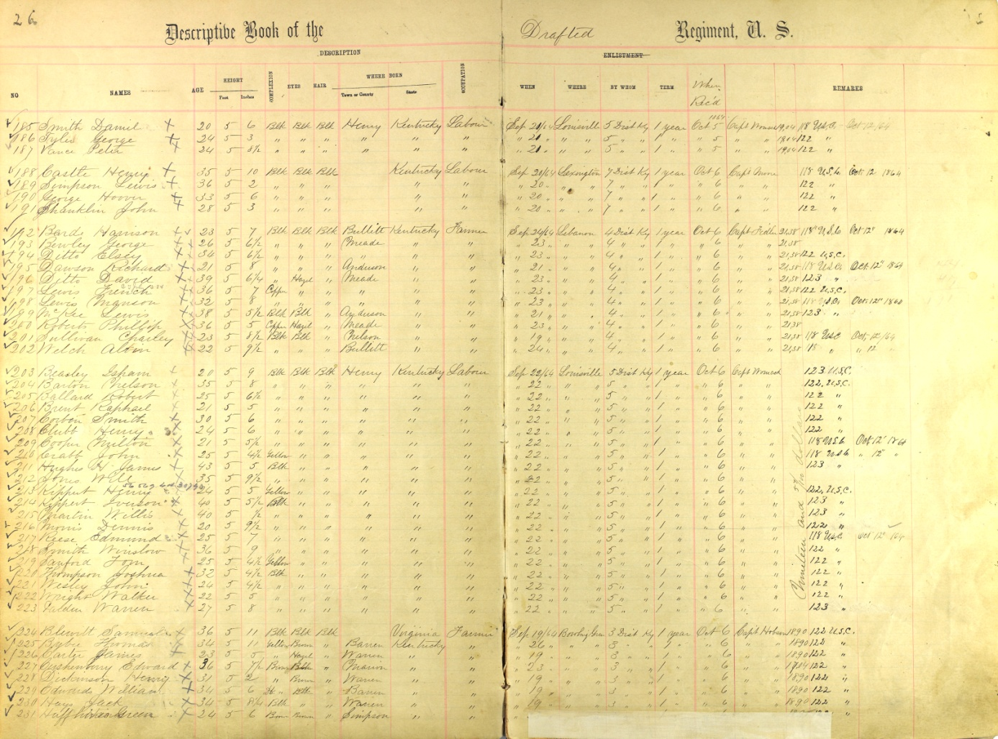
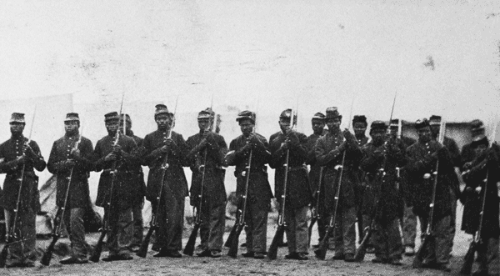
United States Colored Troops (US CT)
Formation of African American Units in Union Army

Slide 4
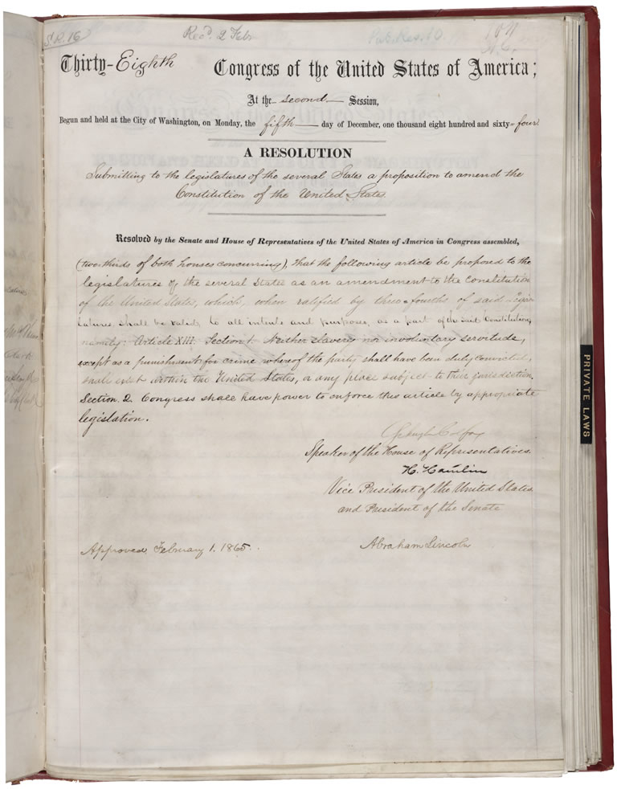
Civil War Amendments to the Constitution: The 13th Amendment
Notes:
13th Amendment abolished slavery in the United States.
Draft of Senate Joint Resolution 16 Submitting the 13th Amendment to the States
ARC Identifier 1943528 / Local Identifier SEN 38A-B2
Item from Record Group 46: Records of the U.S. Senate, 1789 - 2011

Slide 5
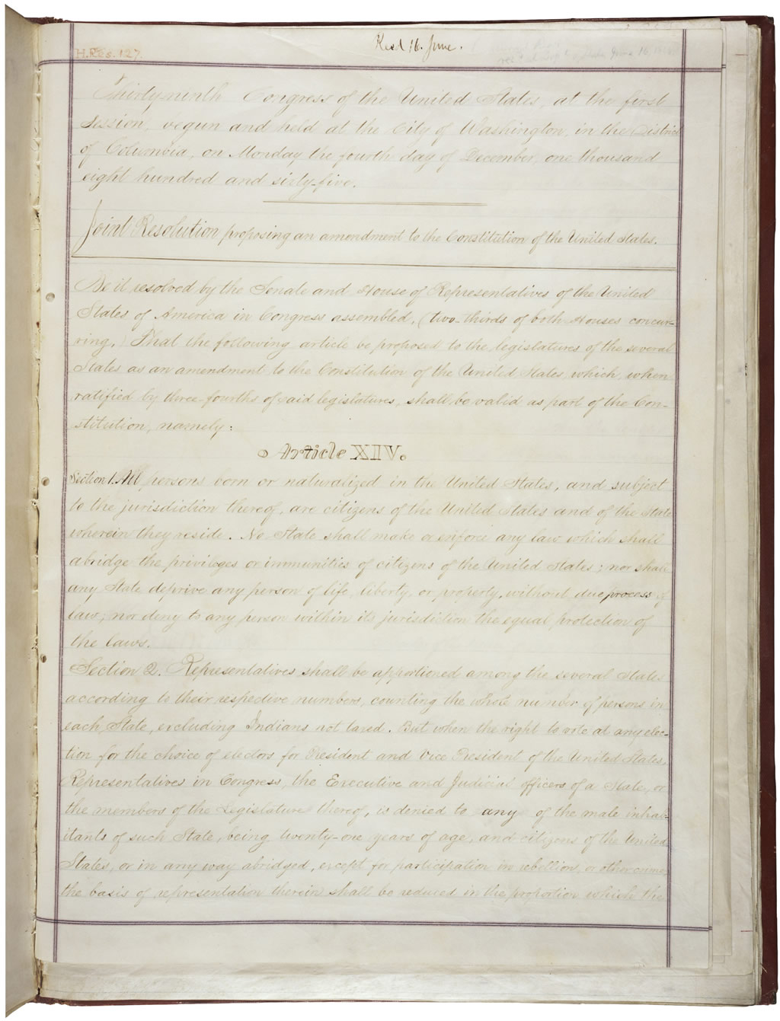
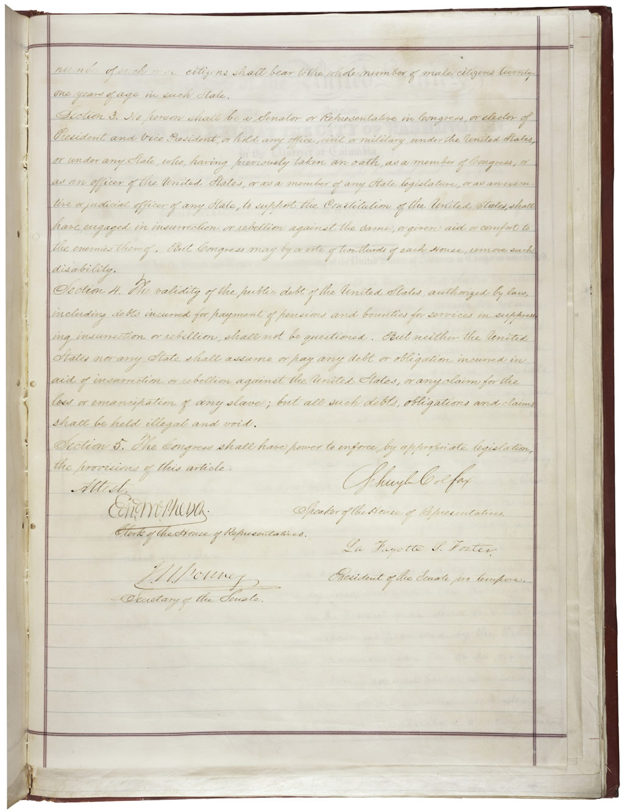
Civil War Amendments: The 14th Amendment
Notes:
The 14th Amendment gave citizenship to all who were/are born in the United States.
Joint Resolution Proposing the Fourteenth Amendment to the United States Constitution, 06/13/1866 - 06/13/1866
ARC Identifier 1408913 / MLR Number A-1 5A (1789-1823 segment), A-1 5B (1824-1956 segment) (...)
Item from Record Group 11: General Records of the United States Government, 1778 - 2006

Slide 6
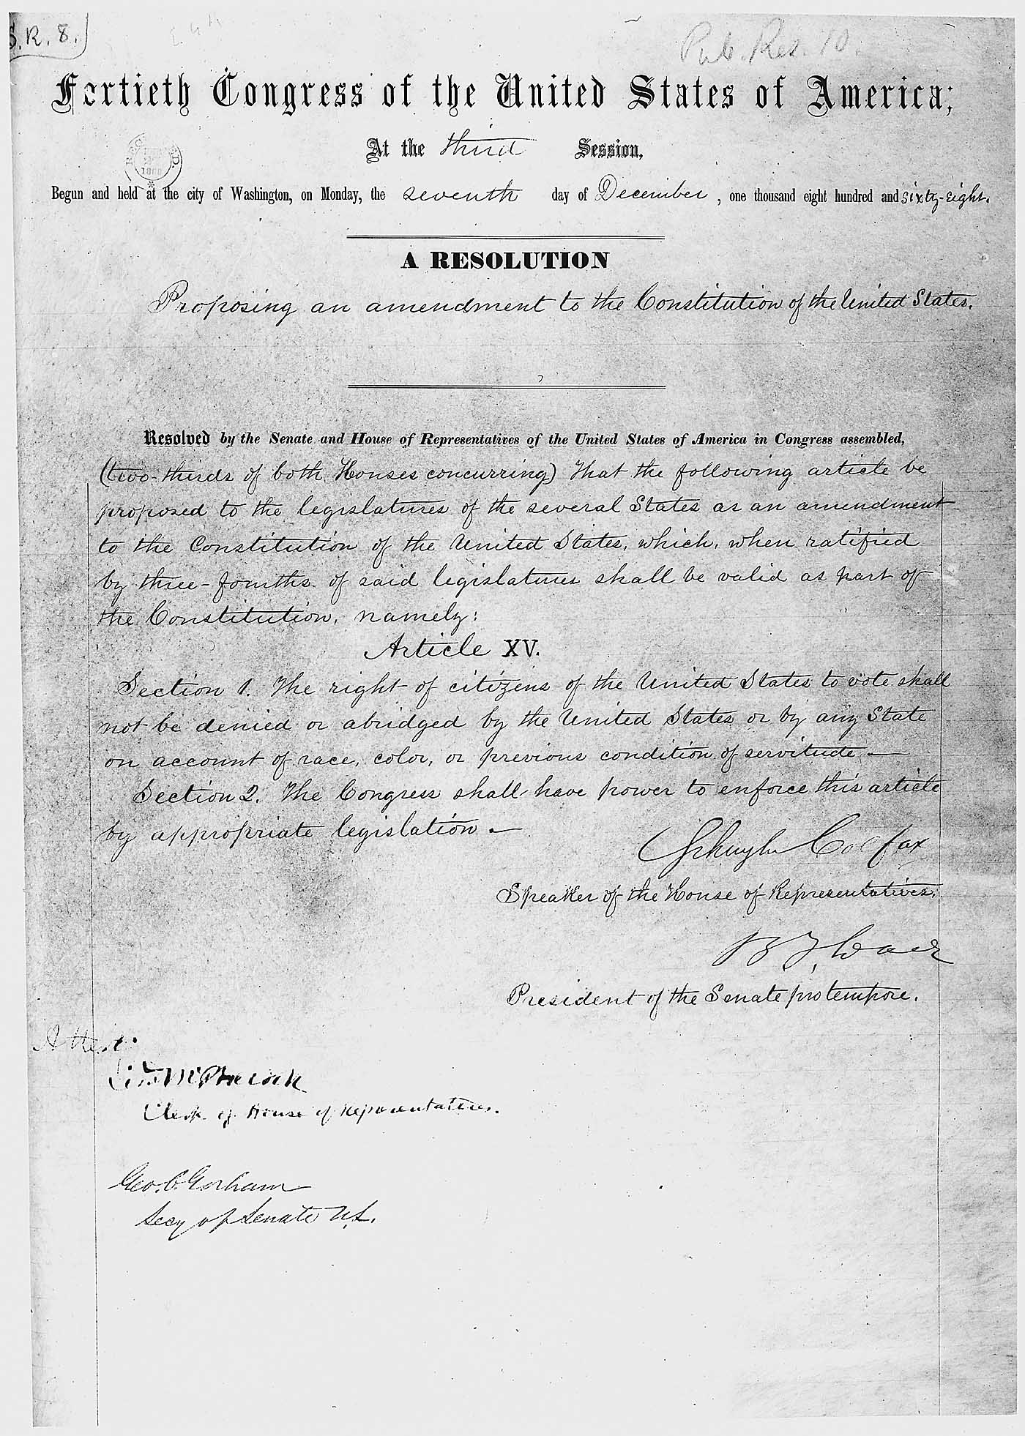
Civil War Amendments: The 15th Amendment
Notes:
The 15th Amendment gave the right to vote to the formerly unslaved.
Joint Resolution Proposing the Fifteenth Amendment to the United States Constitution, 02/26/1869 - 02/26/1869
ARC Identifier 299797 / MLR Number A-1 5A (1789-1823 segment), A-1 5B (1824-1956 segment) (...)
Item from Record Group 11: General Records of the United States Government, 1778 - 2006

Slide 7
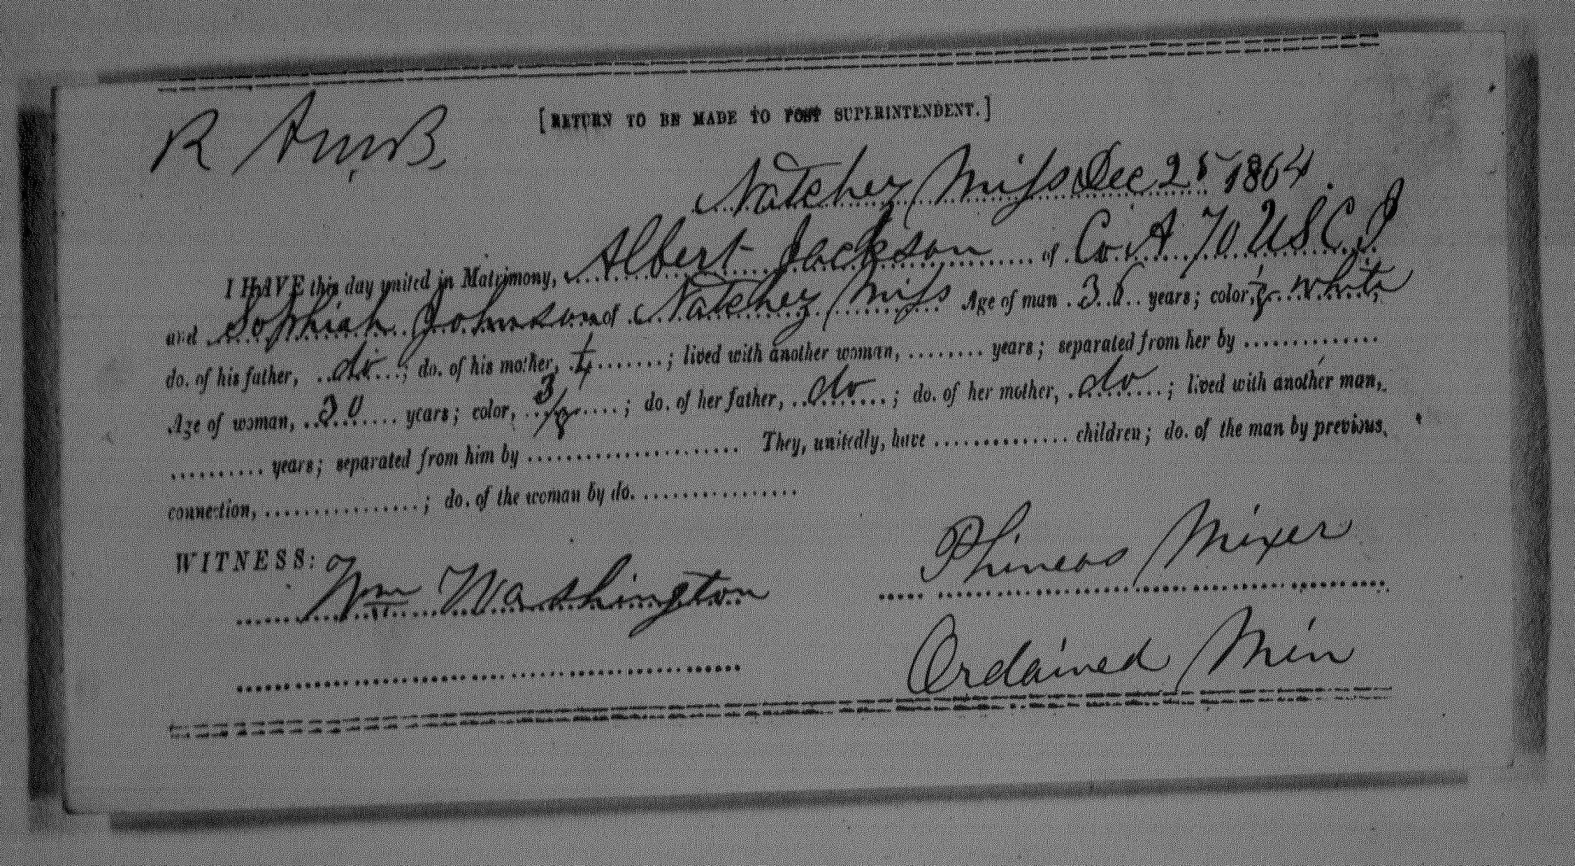
Freedmen’s Bureau
Notes:
National Archives and Records Administration Microfilm: Roll M1907—Records of the Field Offices for the State of Mississippi, Bureau of Refugees, Freedmen, and Abandoned Lands (1865-1872)

Slide 8
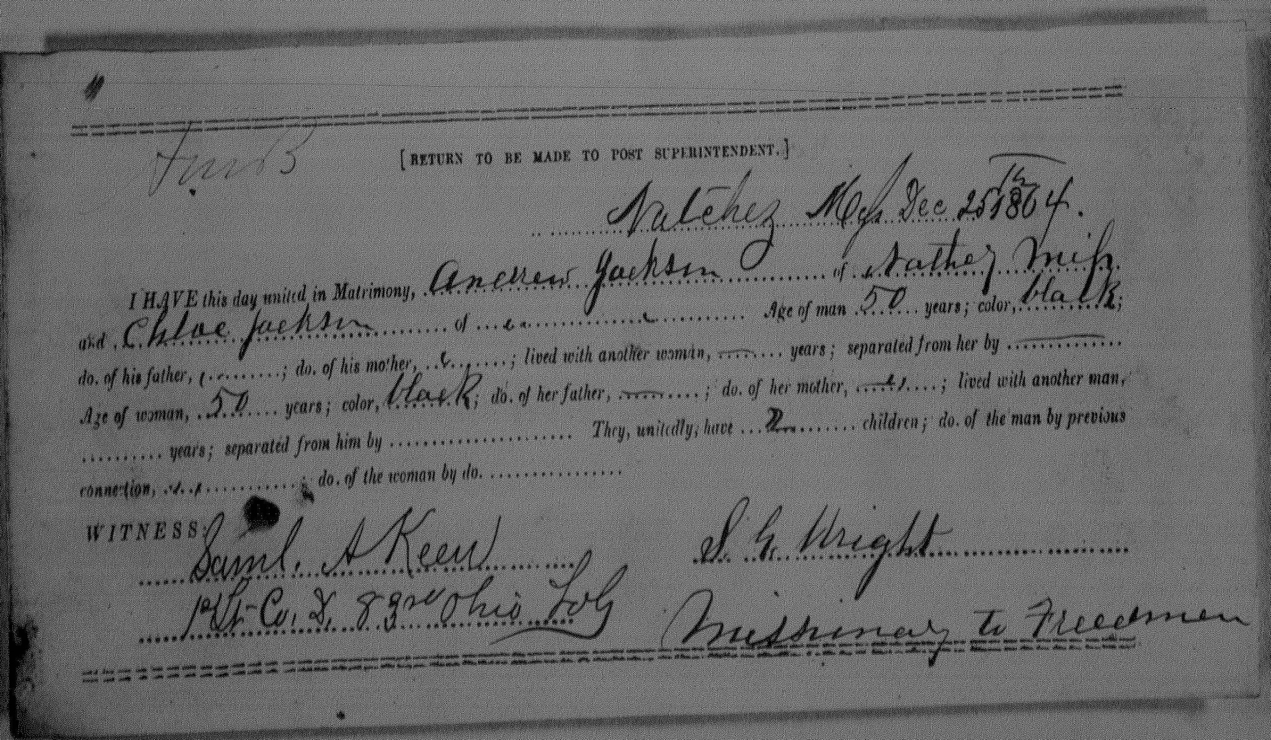
Freedmen’s Bureau
Notes:
The Freedmen’s Bureau was established to help the formerly enslave transition into freedom. This is a marriage license.
National Archives and Records Administration Microfilm: Roll M1907—Records of the Field Offices for the State of Mississippi, Bureau of Refugees, Freedmen, and Abandoned Lands (1865-1872)

Slide 9
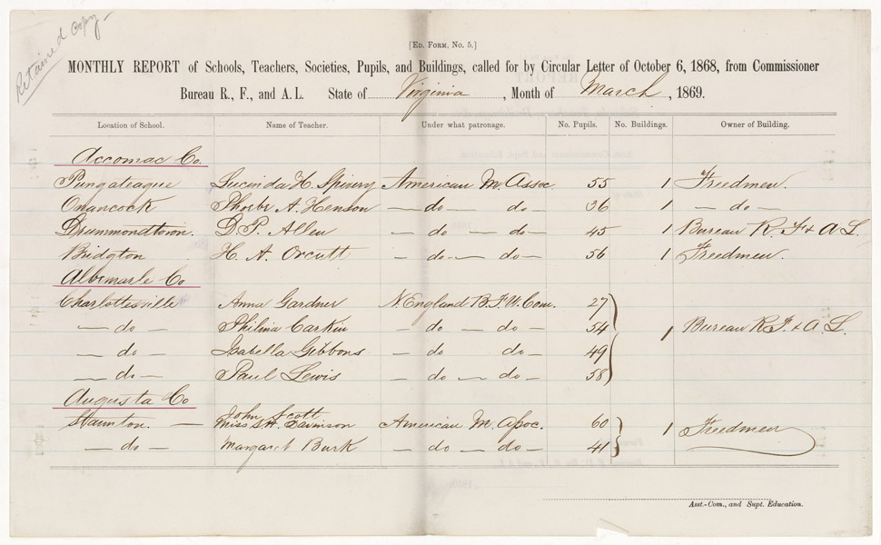
Freedmen’s Bureau
Notes:
Freedmen’s Bureau also set up schools. A handful of schools today claim that they can trace their beginnings to this time period.
Monthly Report of Schools, Teachers, Societies, Pupils, and Buildings, 03/1869
ARC Identifier 4688408 / MLR Number NM-95 3835
Item from Record Group 105: Records of the Bureau of Refugees, Freedmen, and Abandoned Lands, 1861 - 1880

Slide 10
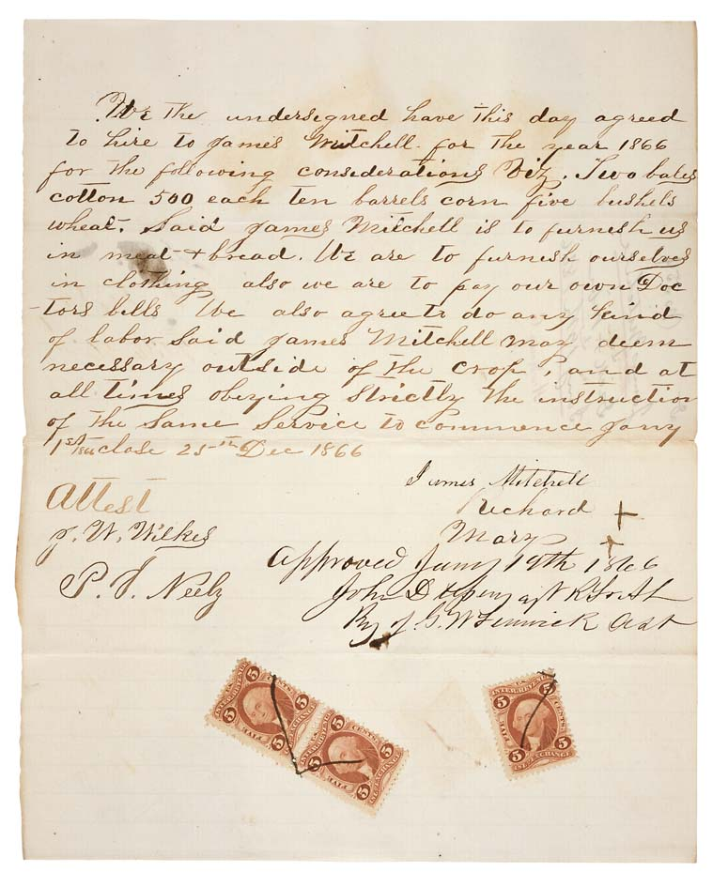
Freedmen’s Bureau
Notes:
One of the duties of the Freemen’s Bureau was to help the formerly enslaved work out labor agreements with employers. Some of the conditions stipulated in these contracts were only slightly better than the conditions of slavery.
Contract Between James Mitchell and Dick and Wife, 01/19/1866
ARC Identifier 595062 / MLR Number NM95 3404
Item from Record Group 105: Records of the Bureau of Refugees, Freedmen, and Abandoned Lands, 1861 - 1880

Slide 11
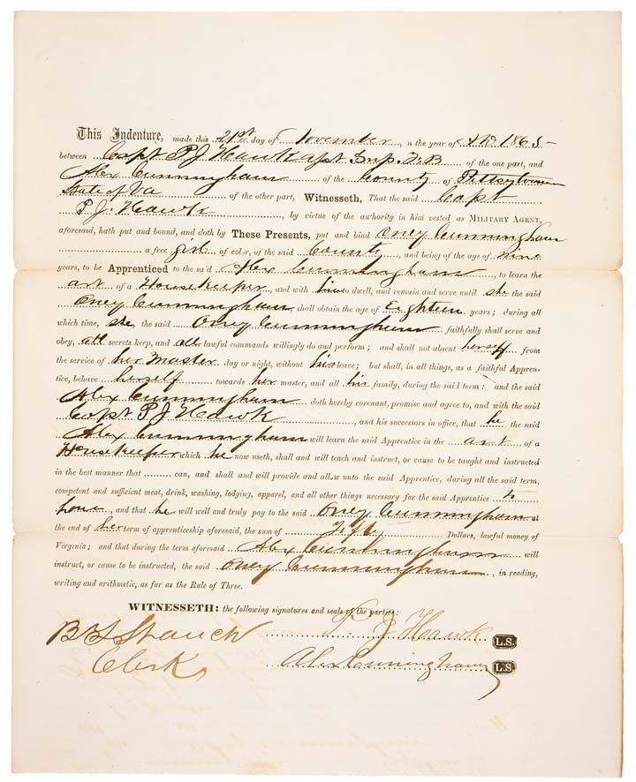
Freedmen’s Bureau
Notes:
Another labor agreement.
Indenture Agreement of Alexander Cunningham
ARC Identifier 595083 / MLR Number NM95 3953
Item from Record Group 105: Records of the Bureau of Refugees, Freedmen, and Abandoned Lands, 1861 - 1880

Slide 12
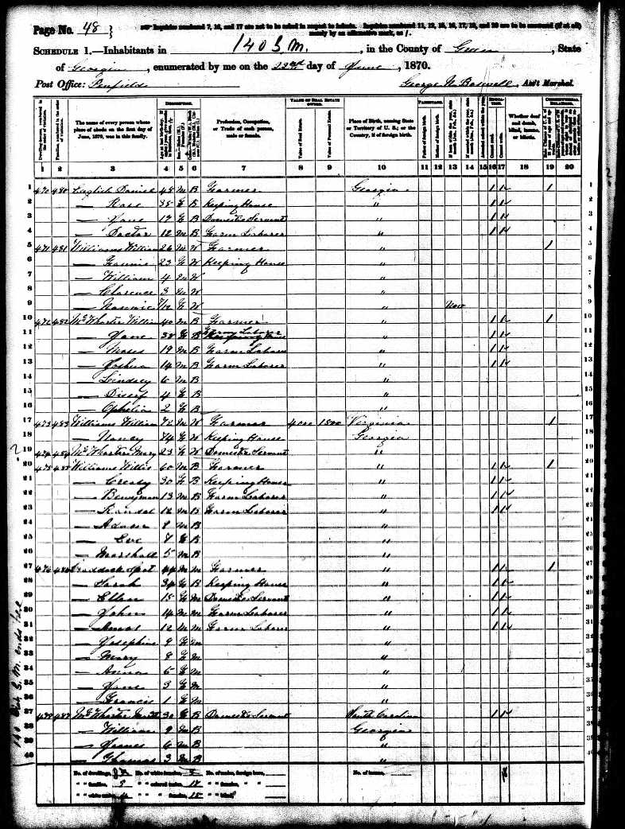
1870 Census: Greene County, Georgia
Notes:
1870 Census for Greene County, Georgia

Slide 13
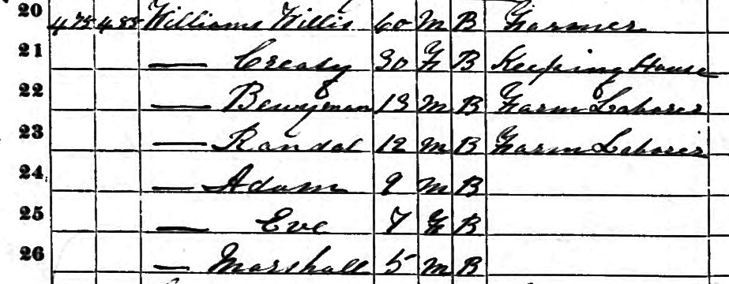
Willis Williams and Family
Notes:
1870 Census for Greene County, Georgia. Note Willis Williams and wife Creasy. Especially notice 9 year old Adam. Adam Williams will grow to be the first pastor of Ebenezer Baptist Church and the grandfather of Martin Luther King.

Slide 17
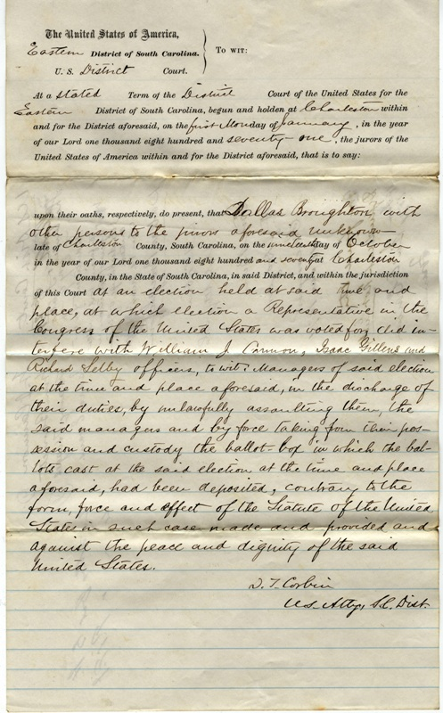
Voting Violations 1870: Interference with election officials
Notes:
The election of 1870 was the first election that African Americans could vote under the 15th Amendment. The next seven slides note the many violations committed during that election.
Roll 579 Box 9 Eastern and Western Districts of South Carolina; All Divisions: Criminal Case Files 1866-1914; Records of the District Courts of the United States; National Archives and Records Administration; National Archives at Atlanta

Slide 18
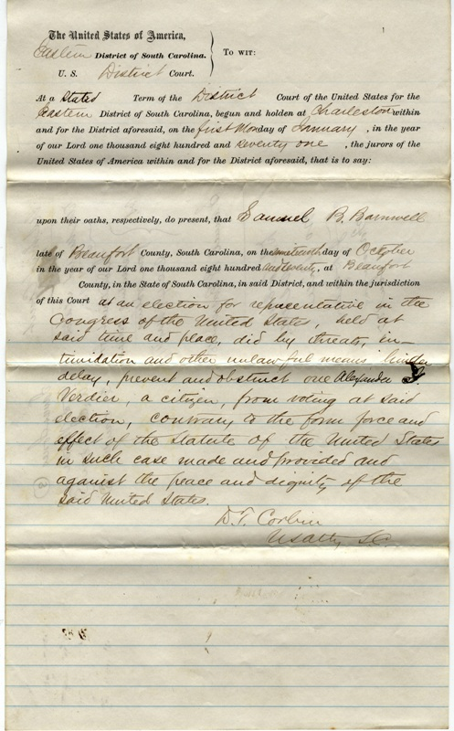
Voting Violations 1870: Intimidation of Voter
Notes:
Roll 577 Box 9 Eastern and Western Districts of South Carolina; All Divisions: Criminal Case Files 1866-1914; Records of the District Courts of the United States; National Archives and Records Administration; National Archives at Atlanta

Slide 19
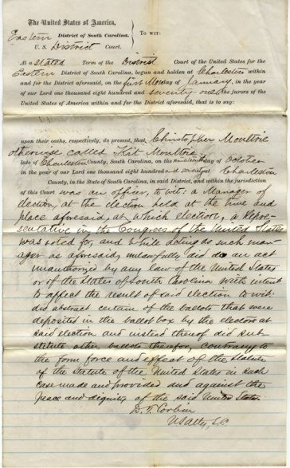
Voting Violations 1870: Official takes out ballots and puts others in
Notes:
Roll 593 Box 9 Eastern and Western Districts of South Carolina; All Divisions: Criminal Case Files 1866-1914; Records of the District Courts of the United States; National Archives and Records Administration; National Archives at Atlanta

Slide 20
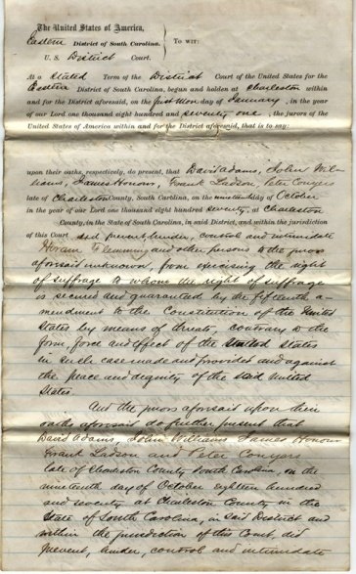
Voting Violations 1870: Violation of 15th Amendment
Notes:
Roll 603 Box 9 Eastern and Western Districts of South Carolina; All Divisions: Criminal Case Files 1866-1914; Records of the District Courts of the United States; National Archives and Records Administration; National Archives at Atlanta

Slide 21
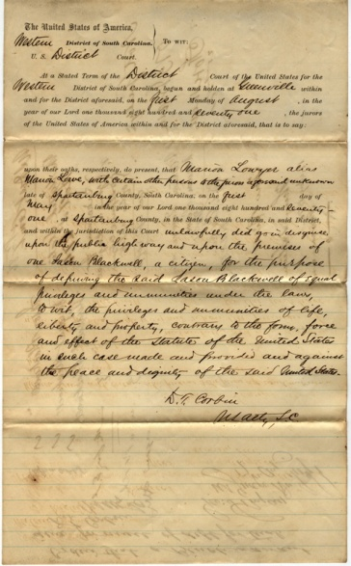
Civil Rights Violation 1870: Unlawfully going in disguise upon Public Highway and upon private premises
Notes:
Roll 674 Box 9 Eastern and Western Districts of South Carolina; All Divisions: Criminal Case Files 1866-1914; Records of the District Courts of the United States; National Archives and Records Administration; National Archives at Atlanta

Slide 22
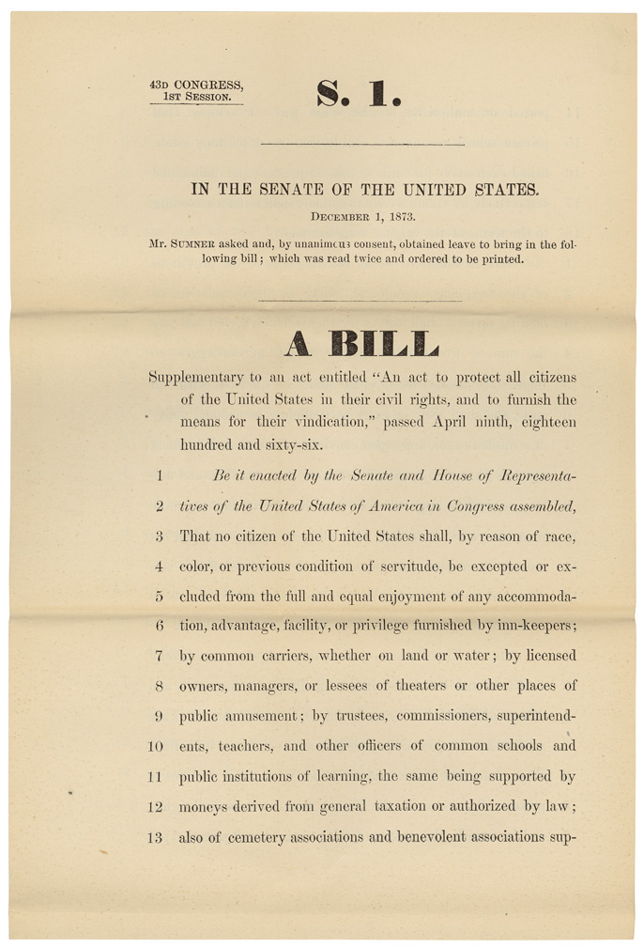
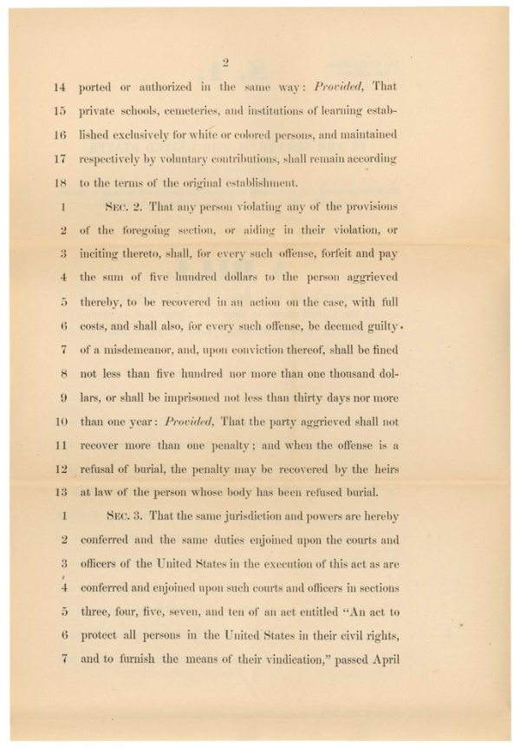
Civil Rights Act of 1875
Notes:
The Civil Rights Act of 1875 gave African Americans the right to equal access to public facilities such as hotels, restaurants, theaters, and other institutions.
Sumner Civil Rights Bill, 12/01/1873
ARC Identifier 1986640 / Local Identifier HR43A-C1
Item from Record Group 233: Records of the U.S. House of Representatives, 1789 - 2011

Slide 23
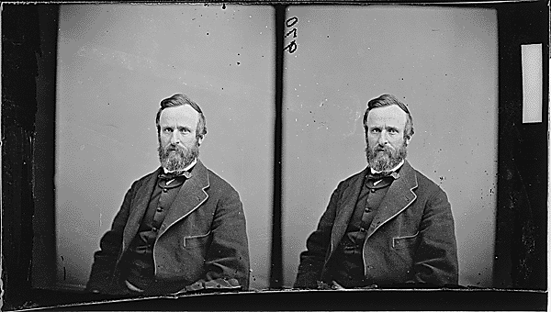
Rutherford B. Hayes and the Presidential Election of 1876
Immediate Results
Dem. Tilden 184, Rep. Hayes 165
20 votes undecided
Florida, Louisiana, South Carolina in dispute
Compromise of 1877?
Hayes gets all 20 votes for the end of Reconstruction
Notes:
During the period of Reconstruction (1865-1877) the federal government attempted to re-construct or re-order the South after the Civil War but white Southerners were not happy with the many rights that the formerly enslaved had attained. Although documentary proof is hard to find, many historians date the end of Reconstruction to the presidential election of 1876. 185 electoral votes were needed to become president in 1876 but after the vote count neither candidate had attained that number but there were 20 votes in dispute. It is believed that a deal was made where the disputed 20 votes went to Republican candidate Rutherford B. Hayes in return for the end of Reconstruction in the South. Whether this is true or not, many of the rights that African Americans had attained by 1875 would begin to disappear after the election.

Slide 24
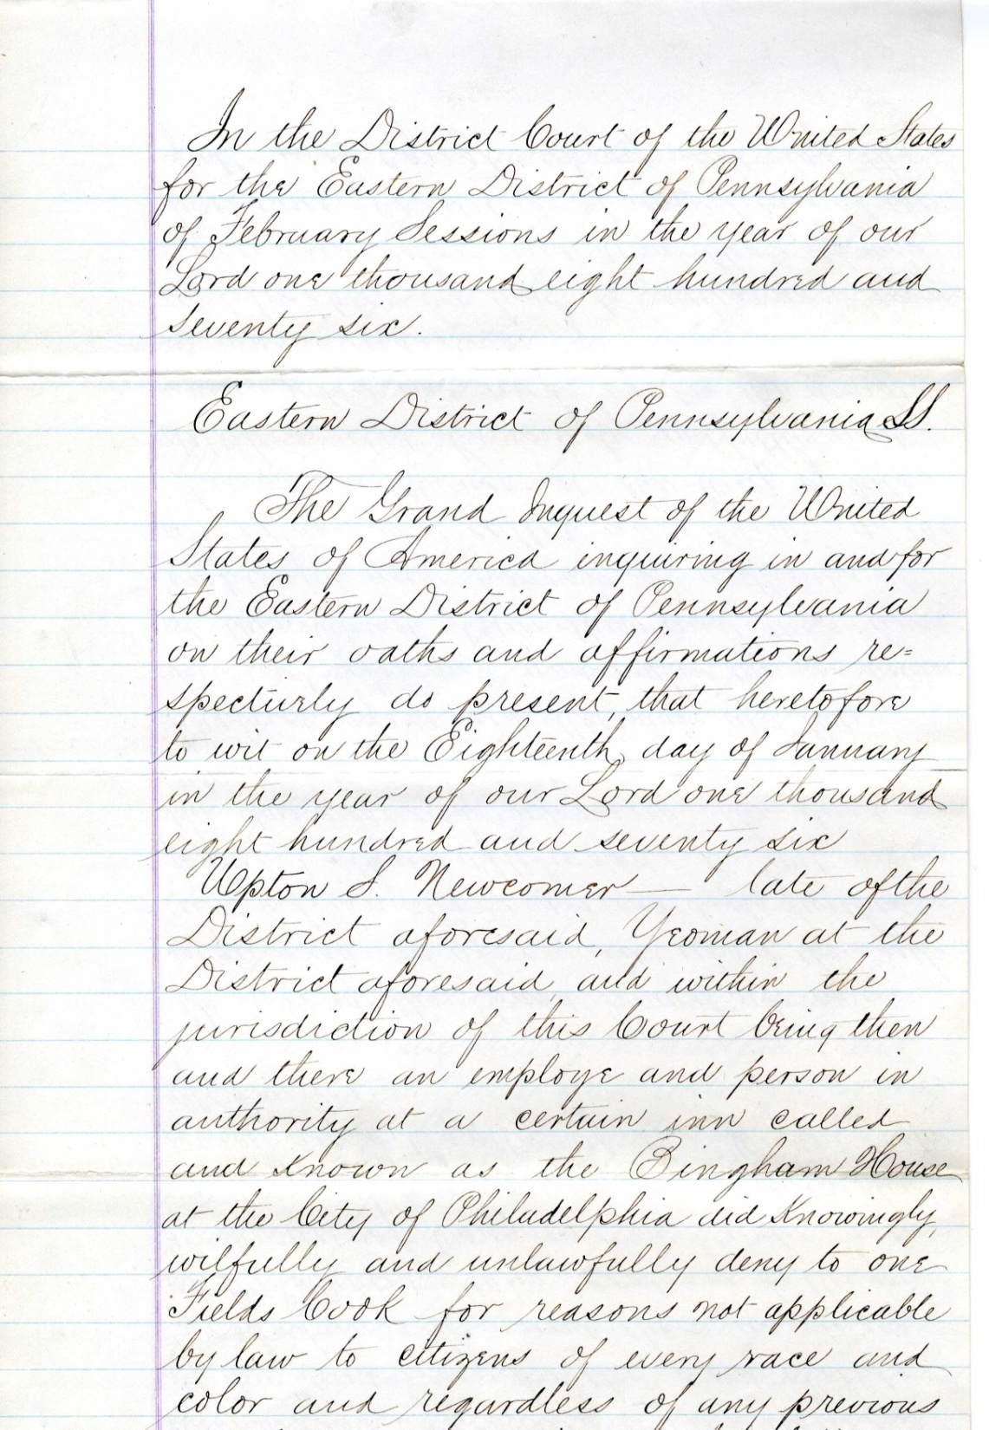
U.S. vs. Newcomer: First Known Civil Rights Case 1876
Notes:
The first test of the Civil Rights Act came in 1876 when Fields Cook, an African American minister, was not allowed to register for a hotel room because of the color of his skin. Upton Newcomer was the clerk who refused to register him. Field Cook won his case and Newcomer had to pay a fine of $500, a considerable sum at that time.
U.S. v. Newcomer
The United States v. Upton S. Newcomer 1876 Records of the U.S. District Court for the Eastern District of Pennsylvania; Records of the District Courts of the United States, Record Group 21; National Archives and Records Administration - National Archives at Philadelphia

Slide 25
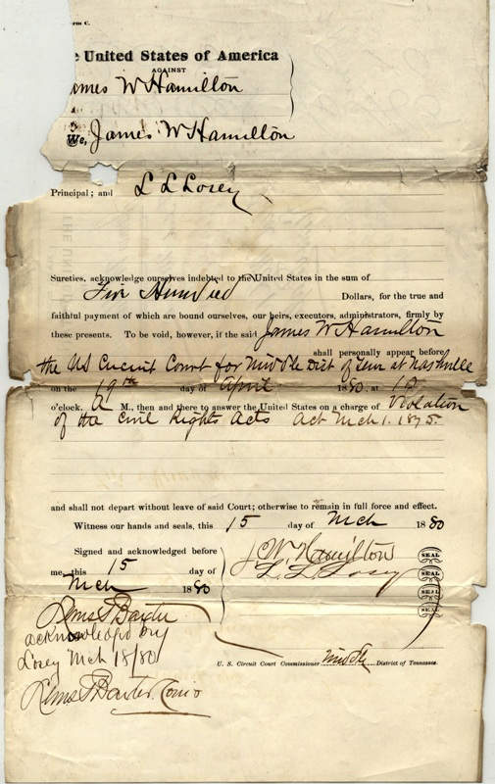
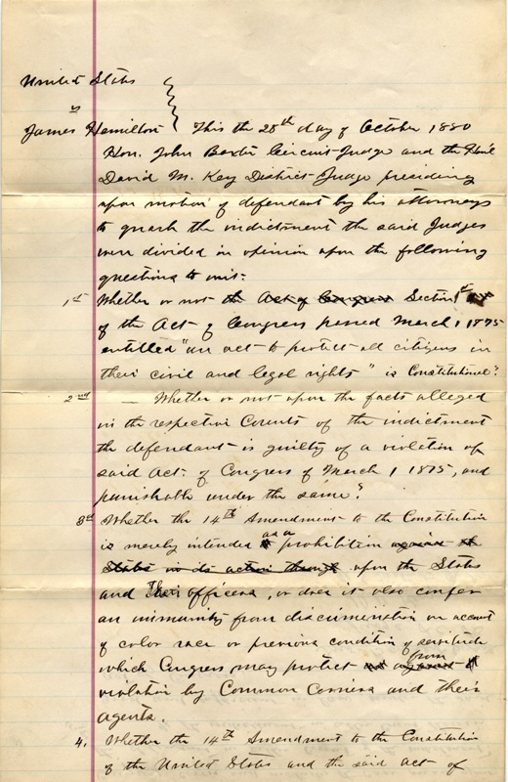
U.S. vs. Hamilton
Notes:
Two cases within the holdings of the National Archives at Atlanta also document attempts to enforce the Civil Rights Act of 1875. In U.S. v. Hamilton, the train conductor is taken to court for not allowing an African American with a first class ticket to ride in first class. The federal district judge does not hear the case but instead decides that the Civil Rights Act of 1875 is unconstitutional and that the case has no merit. The case goes no further than the district court level.
US v. James W. Hamilton, Case #2692; Middle District of Tennessee, Nashville Division; Records of the District Courts of the United States; National Archives and Records Administration; National Archives at Atlanta

Slide 26
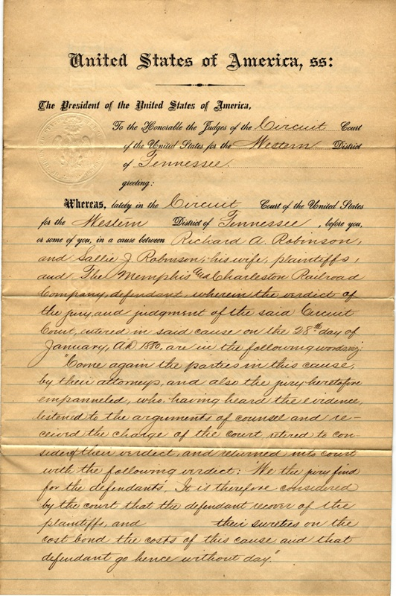
Robinson vs. Memphis and Charleston Railroad: Civil Rights Case 1879
Notes:
In Robinson v. Memphis and Charleston Railroad a train conductor does not allow Sally Robinson and her nephew to ride in the first class passenger car even though they have first class tickets. In the court testimony the conductor states that he initially does not allow them access because he thinks that the nephew is white and that his “date” is not. After the nephew explains that they are both black and related, the conductor does allow them to move back to the first class car. Nonetheless, the Robinson’s still took the case to trial. The judge ruled in favor of the railroad but the case was appealed to the US Supreme Court.
Richard A. Robinson and wife Sally J. v. The Memphis and Charleston Rail Road, Case #2611; Western District of Tennessee, Memphis Division; Records of the District Courts of the United States; National Archives and Records Administration; National Archives at Atlanta

Slide 27
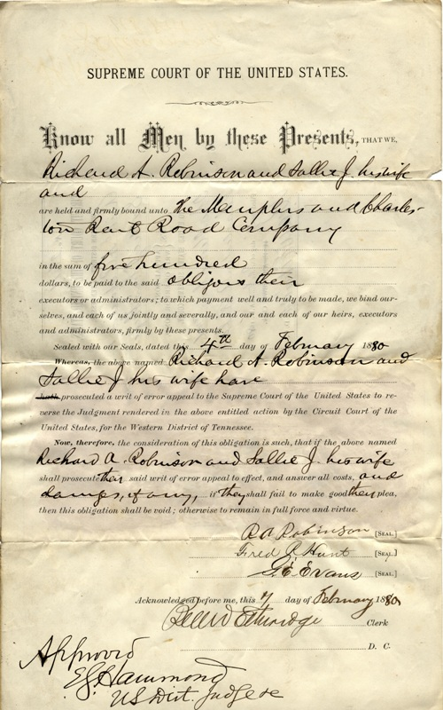
Robinson vs. Memphis R.R. along with 4 other Civil Rights Cases are appealed to the U.S. Supreme Court in 1883 and the Court will find the Civil Rights Act of 1875 unconstitutional
Notes:
Richard A. Robinson and wife Sally J. v. The Memphis and Charleston Rail Road, Case #2611; Western District of Tennessee, Memphis Division; Records of the District Courts of the United States; National Archives and Records Administration; National Archives at Atlanta

Slide 28
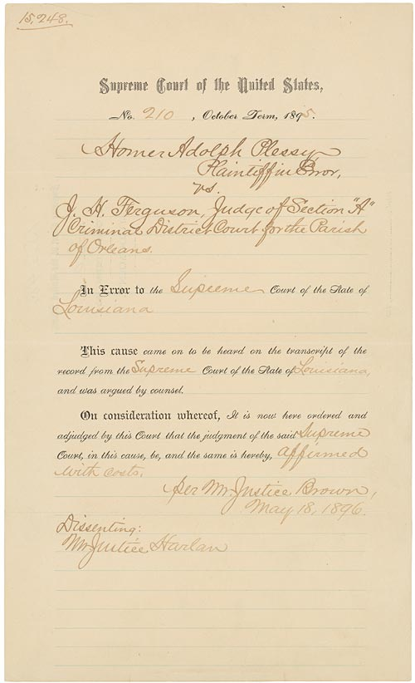
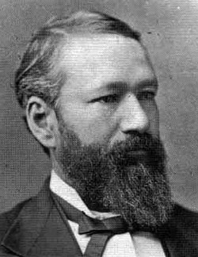
U.S. Supreme Court establishes “Separate But Equal” with 1896 Plessy vs. Ferguson Ruling
Notes:
Homer Plessy, the man in the photograph, was part African American. He challenged the segregated traditions of the South by purchasing a first-class ticket on a Louisiana railroad and then sued for his rights. The US Supreme Court ruled in favor of segregation and established the doctrine of “separate but equal.”
Judgment in Plessy v. Ferguson
ARC Identifier 1685178 / MLR Number A1 21-1792-1933, A1 21-1934-1951 (...)
Item from Record Group 267: Records of the Supreme Court of the United States, 1772 - 2007

Slide 29
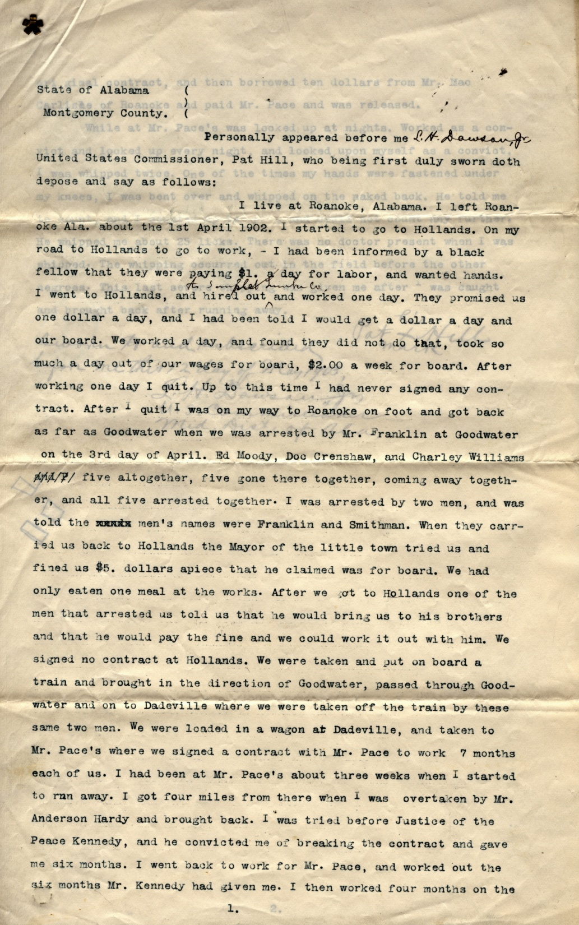
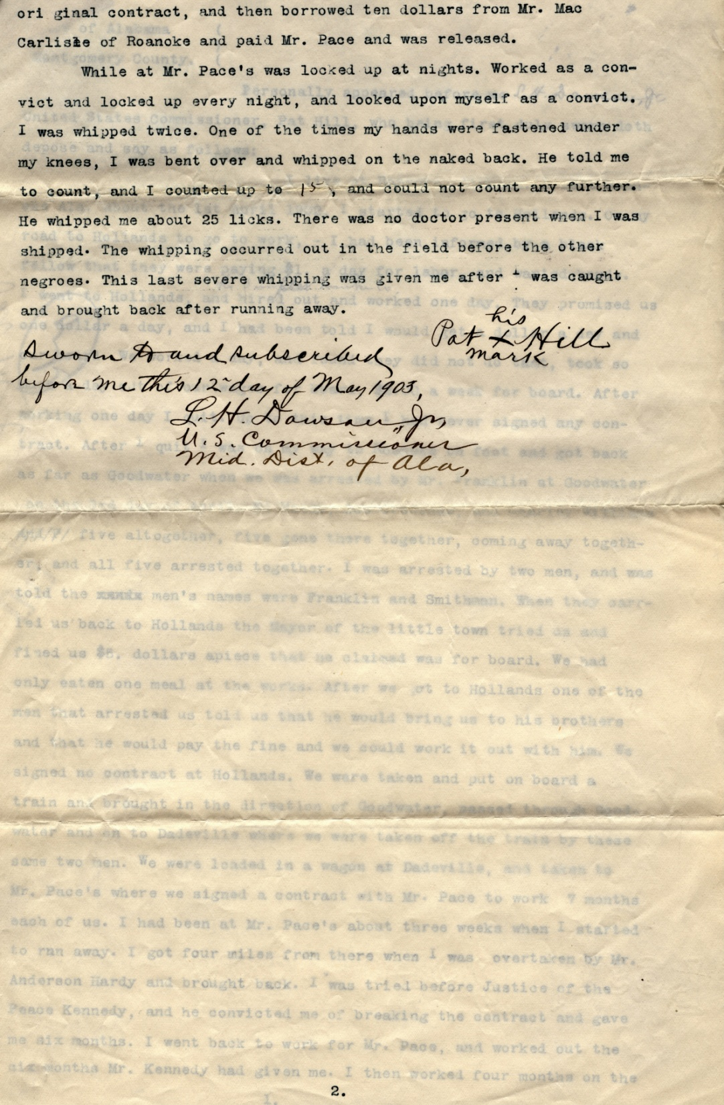
Peonage
Notes:
Affidavit of Pat Hill, 05/12/1903
ARC Identifier 2641475
Item from Record Group 21: Records of District Courts of the United States, 1685 - 2004

Slide 30
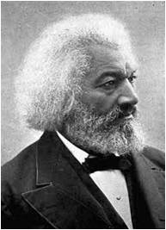
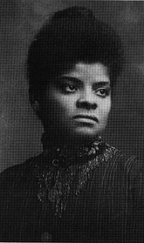
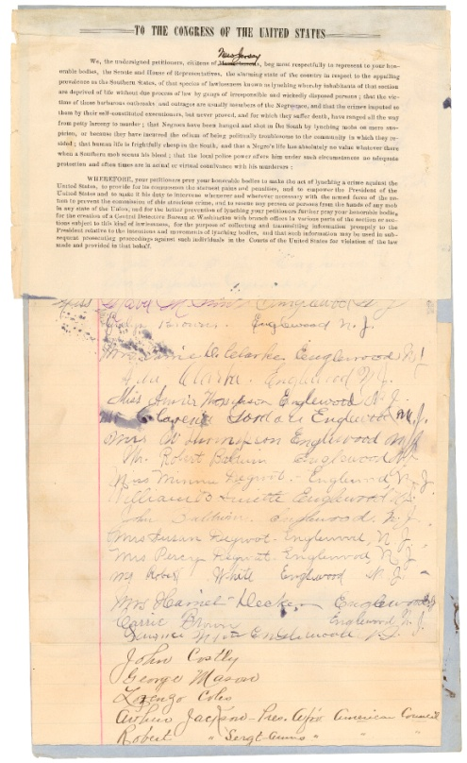
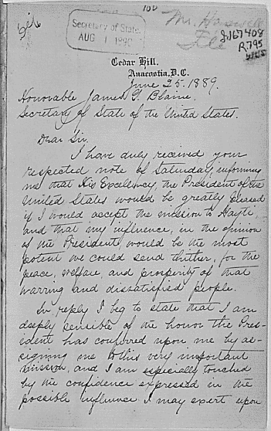
Civil Rights at the Dawn of the Jim Crow Era: Old Guard
Notes:
Even though the social climate had changed, many continued to fight for Civil Rights. Frederick Douglas was still a prominent player, being appointed ambassador to Haiti and fighting for the right for African Americans to enjoy the Chicago World’s Fair in 1893. Ida B. Wells fought to end the practice of lynching in the United States. Booker T. Washington worked to help African American gain the labor skills they would need to gain footing in the American economy. W.E.B. Dubois fought for intellectual freedom and black access into white universities and colleges.
Letter from Frederick Douglass to Secretary of State James G. Blaine, Accepting the Appointment as U.S. Minister to Haiti, 06/25/1889
ARC Identifier 302033 / MLR Number A1 85
Item from Record Group 59: General Records of the Department of State, 1763 - 2002
Petition from the citizens of New Jersey praying for Congress to make the act of lynching a crime against the United States, 02/21/1900
ARC Identifier 306656
Item from Record Group 233: Records of the U.S. House of Representatives, 1789 - 2011

Slide 31
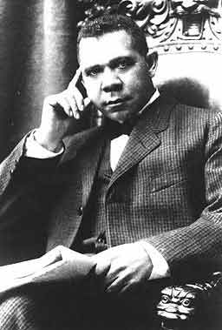
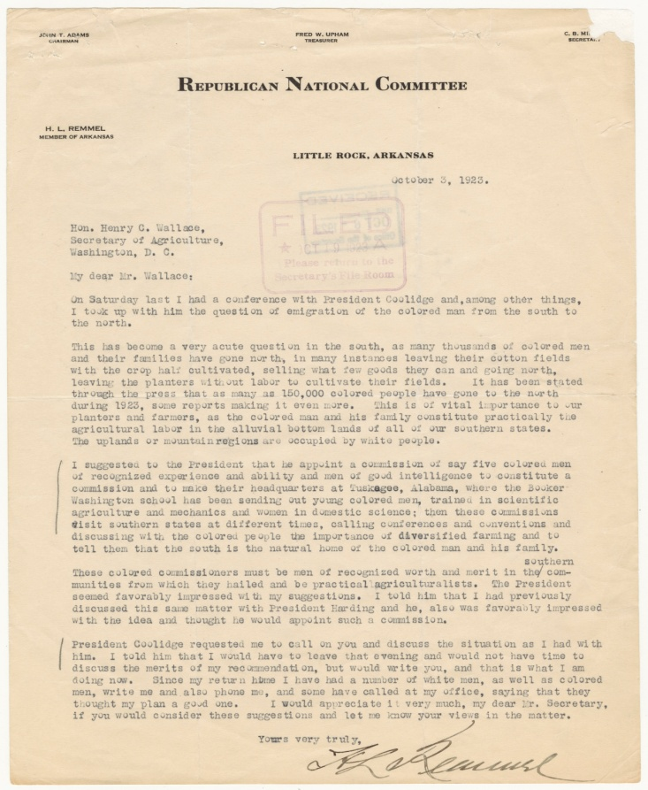
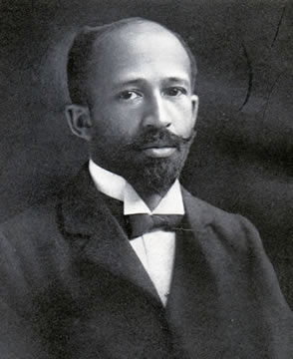
Civil Rights at the Dawn of the Jim Crow Era: Conflict and Compromise

Slide 32
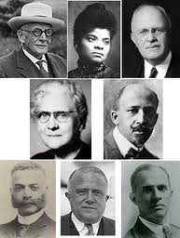
Birth of the NAACP: 1909
Notes:
The oldest Civil Rights organization was established by a diverse group on February 12, 1909.

Slide 33
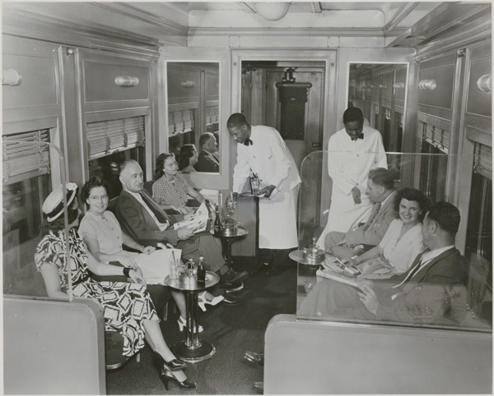
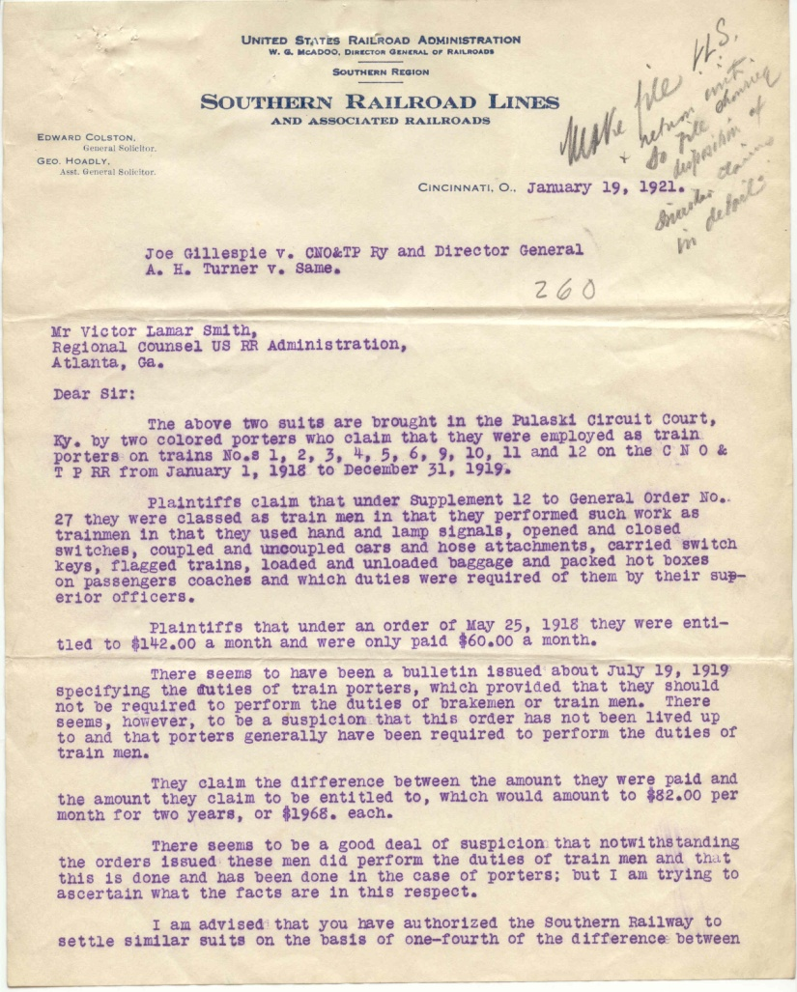
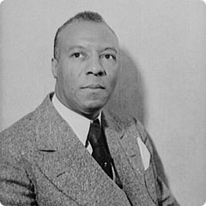
Brotherhood of Colored Sleeping Car Porters
Notes:
This document shows the early attempts a black porters to organize for better treatment by the railroads. By 1925, the porters had organized into the Brotherhood of Sleeping Car Porters and elected A. Philip Randolph as the president of their union. Both the union and Randolph would play a major role in the advancement for Civil Rights.
Negro Train Porters vs. Southern R.R. System, File Code 260; Records of the United State Railroad Administration; National Archives and Records Administration; National Archives at Atlanta

Slide 34
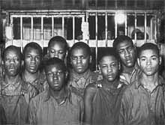
Scottsboro Boys: Defended by the Attorneys from the American Communist Party
Notes:
In the 1930s seven young African American men were “hoboing” on a train travelling through Alabama. They would later be charged with abusing two white women who were also “hoboing” on the same train. The white women later recanted their story that they had been abused by the seven men. Nonetheless a trial was still held and they were sent to prison. This court case in not part of the National Archives holdings since it was tried in a non-federal court. These men may have better been served by NAACP lawyers than Communist Party lawyers.

Slide 35
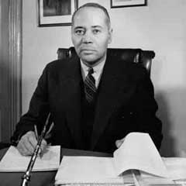
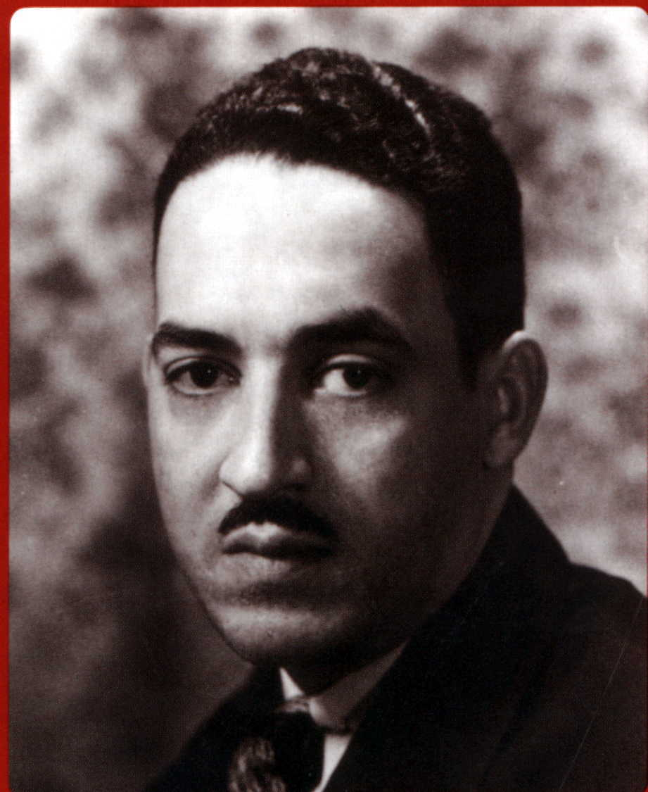
Charles Houston
Thurgood Marshall
Notes:
By the 1930s the NAACP had a strong legal team led by the experienced Charles Houston and the young Thurgood Marshall. Marshall, decades later, would become the first African American appointed to the US Supreme Court.

Slide 36
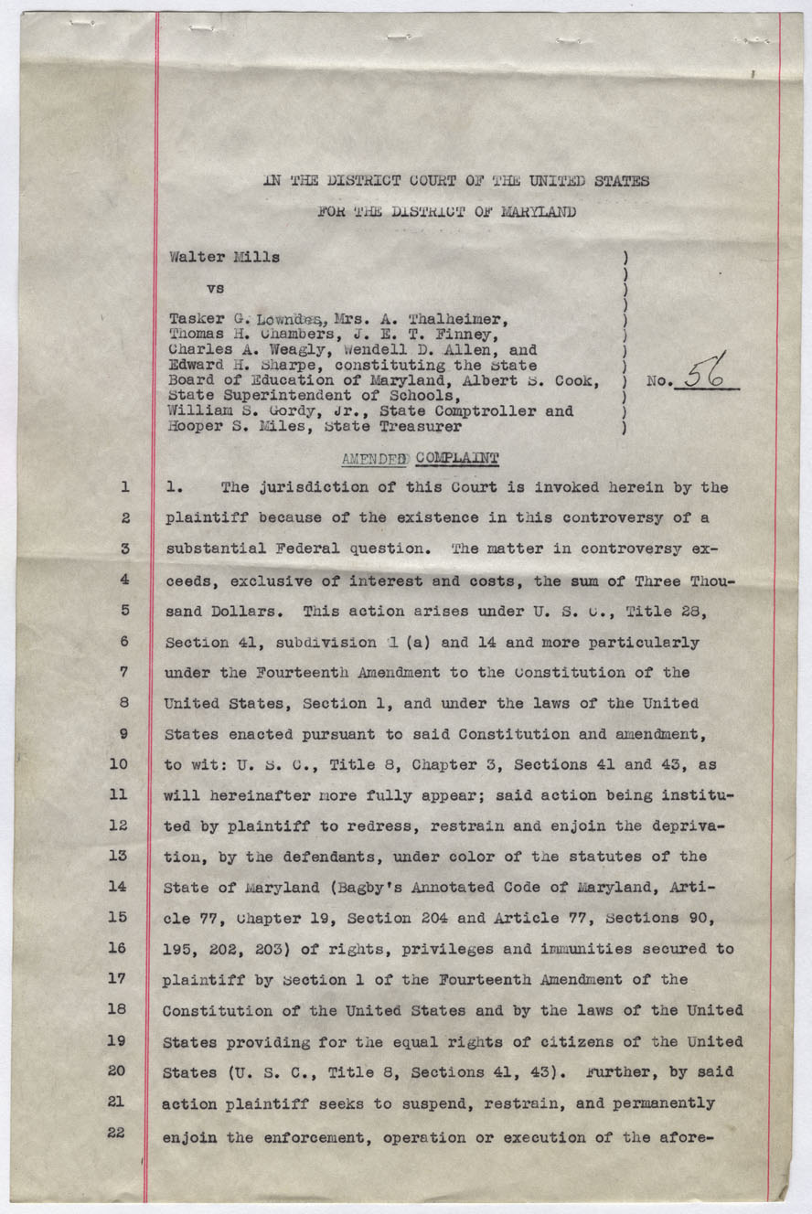
Mills v. Lowndes
Notes:
During the 1940s, the NAACP legal team took numerous cases to court where they sued for equal pay for black teachers. The first case, Mills v. Lowndes, they did not win but they win most of them after that. Many of these court cases are housed in the National Archives at Atlanta
Mills v. Lowndes
Walter Mills v. Tasker G. Lowndes, et al. 1939 Case No. 56 Records of the U.S. District Court for the District of Maryland 1939; Records of the District Courts of the United States, Record Group 21; National Archives and Records Administration - National Archives at Philadelphia

Slide 37
A. Philip Randolph and the Federal Employment Practices Commission
Notes:
In the spring of 1941, A. Philip Randolph threatened a “March on Washington” unless African Americans were granted equal opportunity in the war industries manufacturing material for World War II. President Franklin Roosevelt did not want a march on Washington so signed Executive Order 8802 establishing the Fair Employment Practices Commission, a federal agency to promote equal opportunity and investigate violations. The FEPC did not have much power to enforce equality especially in the South
Executive Order 8802 Dated June 25, 1941, in which President Franklin D. Roosevelt Prohibits Discrimination in the Defense Program, 06/25/1941 - 06/25/1941
ARC Identifier 300005 / MLR Number A1 30
Item from Record Group 11: General Records of the United States Government, 1778 - 2006
Draft news release relating to the recent disturbances in Mobile at the Alabama Dry Dock and Shipbuilding Corporation., 05/27/1943
ARC Identifier 281526
Item from Record Group 211: Records of the War Manpower Commission, 1936 - 1951

Slide 38
U.S. vs. Shull 1946
Notes:
After World War II Isaac Woodward, a African American recently discharged from the Army, was taken from a commercial bus traveling through South Carolina and beaten up by police. In the process, he was made blind. The police were tried in federal court for violation of Woodward’s rights but a jury found the police innocent.
U.S.A. v. Lynwood Lanier Shull #16603; Criminal Cases, Eastern District of South Carolina (Columbia; Records of the District Courts of the United States; National Archives and Records Administration; National Archives at Atlanta

Slide 39
Letter Referring to the Shull Case
Notes:
Shortly after the Shull case, President Truman referred to it in the above letter as a reason why things had to change.
Letter from Harry S. Truman to Ernie Roberts, 08/18/1948
ARC Identifier 201511
Item from Collection HST-PSF: President's Secretary's Files (Truman Administration), 1945 - 1960

Slide 40
Integration of the U.S. Military
Notes:
This is the order that integrated the U.S. military
Executive Order 9981, July 26, 1948; General Records of the United States Government; Record Group 11; National Archives.

Slide 41
Presidential Election of 1948
Democratic Party Splits when Southern Democrats form the Dixiecrat Party and nominate Strom Thurmond
Near-certain victory for Republican Candidate, Thomas Dewey
Notes:
Because of Truman’s stand on Civil Rights, specifically the integration of the military, his political party split in two with the formation of the Dixie-crats. This meant almost certain defeat for him when he ran for re-election in 1948. Amazingly, Truman won. This was a case when the news media called the election for one candidate but got it wrong in the end.

Slide 42
Elmore v. Rice, 1947
Notes:
The state of South Carolina did not allow African Americans the right to vote in primary elections. George Elmore challenged this law in federal district court. His lawyer was Thurgood Marshall. Federal judge J. Waties Waring ruled in favor of George Elmore and in 1948 African Americans were allowed to vote in the primaries.
George Elmore v. Clay Rice Case #1702; Civil Case Files; Eastern District of South Carolina, All Division; Records of the District Courts of the United States; National Archives and Records Administration; National Archives at Atlanta

Slide 43
Briggs v. Elliott
Notes:
In 1949, African American families in Clarendon County, South Carolina sued for better schools for their children. The case was named for Harry Briggs (pictured with his wife) since he was the first parent to sign the petition sent to the school board demanding better schools.
Briggs v. Elliott Case #2657; Civil Case Files; Eastern District of South Carolina, Charleston Division; Records of the District Courts of the United States; National Archives and Records Administration; National Archives at Atlanta

Slide 44
Notes:
Three federal judges heard Briggs v. Elliott. Two of the judges ruled in favor of the white school board and the state of South Carolina. One judge, Judge J. Waties Waring dissented and ruled in favor of Briggs.
Briggs v. Elliott Case #2657; Civil Case Files; Eastern District of South Carolina, Charleston Division; Records of the District Courts of the United States; National Archives and Records Administration; National Archives at Atlanta

Slide 45
Notes:
Judge Waring wrote a 21-page dissenting opinion explaining why segregation was wrong. Briggs v. Elliott was appealed to the US Supreme Court, becoming the first case in Brown v. Board of Education of Topeka. Many believe the Judge Waring’s dissension had a major effect on the Supreme Court’s ruling in favor of Brown.
Briggs v. Elliott Case #2657; Civil Case Files; Eastern District of South Carolina, Charleston Division; Records of the District Courts of the United States; National Archives and Records Administration; National Archives at Atlanta

Slide 46
Brown v. Board of Education of Topeka
Notes:
Notice that the Briggs Case was the first heard in Brown v. Board of Education
Order of Argument, 1953
ARC Identifier 1656509 / MLR Number A1 21-1792-1933, A1 21-1934-1951 (...)
Item from Record Group 267: Records of the Supreme Court of the United States, 1772 - 2007

Slide 47
Ruling on Brown v. Board by the U.S. Supreme Court
Notes:
The Brown Ruling callled for the end of segregated schools.
Judgment, Brown v. Board of Education, 05/31/1955
ARC Identifier 301669 / MLR Number A1 21-1792-1933, A1 21-1934-1951 (...)
Item from Record Group 267: Records of the Supreme Court of the United States, 1772 - 2007

Slide 48
The Arrest of Rosa Parks
Notes:
Police Report on Arrest of Rosa Parks
ARC Identifier 596074
Item from Record Group 21: Records of District Courts of the United States, 1685 - 2004

Slide 49
Browder v. Gayle Plaintiffs: Aurelia Browder, Suzie McDonald, Claudette Colvin, and Mary Louise Smith
Notes:
Browder v. Gayle was the court case involving the four young women that had been arrested before Rosa Parks. It was this court case that was the legal victory that allowed for the ultimate success of the Montgomery Bus Boycott.
Judgment from Aurelia Browder et al. v. W. A. Gayle et al.
ARC Identifier 279206
Item from Record Group 21: Records of District Courts of the United States, 1685 - 2004

Slide 50
Integration of Central High School in Little Rock, Arkansas
Notes:
In the fall of 1957 nine African American students integrated Central High School in Little Rock, Arkansas. There were protests by the white community. President Eisenhower sent the military in the keep order.
Diary Dictated by President Eisenhower on October 8, 1957 Concerning the Visit of Governor Orval Faubus on September 14, 1957, 10/08/1957
ARC Identifier 186622
Item from Collection DDE-EPRES: Eisenhower, Dwight D.: Papers as President of the United States, 1953 - 1961
Letter to President Dwight D. Eisenhower from Rev. Fr. Richard P. Adair Regarding Little Rock, Arkansas, 09/25/1957
ARC Identifier 6092865
Item from Collection DDE-WHCF: White House Central Files (Eisenhower Administration), 1953 - 1961

Slide 51
The Movement Escalates: Sit-Ins, Freedom Riders, University Integration
Notes:
By the early 1960s, the Civil Rights Movement included such events as the Greensboro, NC sit-in, the Freedom Riders where protestors rode commercial buses into the Deep South, and James Meredith’s integration of the University of Mississippi.
Order from United States vs. United States Klans, 09/1938 - 11/26/1968
ARC Identifier 279202
Item from Record Group 21: Records of District Courts of the United States, 1685 - 2004
Kennedy Telegram to Barnett September 29, 1962, 09/29/1962
ARC Identifier 193813
Item from Collection JFK-POF: Papers of John F. Kennedy: President's Office Files, 01/20/1961 - 11/22/1963

Slide 52
Notes:
The March on Washington in 1963. The main organizer was A. Philip Randolph, the man who had threatened the March on Washington in 1941. Randolph appears in the upper right and lower left photograph. His image is also the one that appears on the first slide of this presentation.

Slide 53
March on Selma March 7, 9, and 16, 1965 16
Notes:
It was the marches on Selma that united much of the nation to support the growing Civil Rights Movement.
Testimony from Hosea Williams, John Lewis, and Amelia Boynton et al. v. Honorable George C. Wallace, Governor of Alabama et al.
ARC Identifier 279204
Item from Record Group 21: Records of District Courts of the United States, 1685 - 2004

Slide 54
The Civil Rights Act of 1964 and the Voting Rights Act of 1965
Notes:
President Lyndon Johnson, a white southerner, fought for and got enacted the Civil Rights Act of 1964 and the Voting Rights Act of 1965.
House Resolution 6400, the Voting Rights Bill, 05/14/1965
ARC Identifier 1991043
Item from Record Group 233: Records of the U.S. House of Representatives, 1789 - 2011

Slide 55
The Assassination of Martin Luther King
Notes:
The nation was shocked in April 1968 with the assassination of Dr. Martin Luther King who had led the Civil Rights Movement since the Montgomery Bus Boycott.
Senator Robert F. Kennedy spoke in honor of Dr. King after his death. Senator Kennedy would also be assassinated that same year. Dr. King died in Memphis, Tennessee where he was supporting the Memphis Garbage Workers in their attempt for better working conditions.
Opinion and Temporary Injunction, 1968
ARC Identifier 641661
Item from Record Group 21: Records of District Courts of the United States, 1685 - 2004
Statement by Senator Robert F. Kennedy on the Death of the Reverend Martin Luther King April 4, 1968, 04/04/1968
ARC Identifier 194037
Item from Collection JFK-RFK: Robert F. Kennedy Papers, 1937 - 06/06/1968

